Slide 1
Physics of MOS Transistor

Slide 2
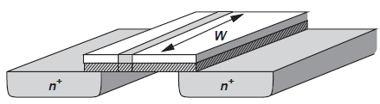
Derivation of I/V Characteristics
Channel Charge Density
The channel charge (i.e., free electrons) per unit length is called the “charge density.”
If C is the gate capacitance per unit length and V the voltage difference between the gate and the channel, then Q is the desired charge density; i.e., Q = CV.
Denoting the gate capacitance per unit area by C_{ox} and W the width of the transistor, we write C = WC_{ox}.
Moreover, we have V = V_{GS} − V_{TH} because no mobile charge exists for V_{GS} < V_{TH}.
It follows that
2

Slide 3
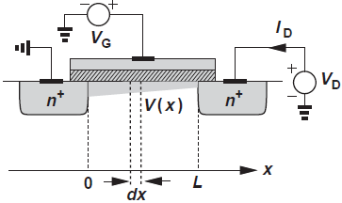
Derivation of I/V Characteristics(2)
The channel voltage varies along the length of the transistor, and the charge density falls as we go from the source to the drain.
Thus, Eq. (i) is valid only near the source terminal, where the channel potential remains close to zero.
As shown in Fig., we denote the channel potential at x by V(x) and write
noting that V(x) goes from zero to V_{D} if the channel is not pinched off.
3

Slide 4
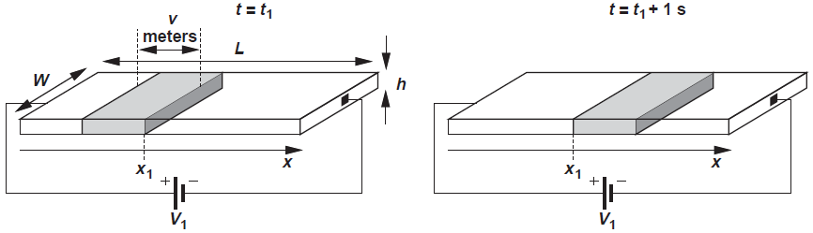
Derivation of I/V Characteristics(3)
Drain Current
Consider a bar of semiconductor having a uniform charge density (per unit length) equal to Q and carrying a current I.
I is given by the total charge that passes through the cross section of the bar in one second, and if the carriers move with a velocity of v m/s, then the charge enclosed in v meters along the bar passes through the cross section in one second.
Since the charge enclosed in v meters is equal to Q · v, we have
2

Slide 5
Derivation of I/V Characteristics(4)
We know the velocity, v, is proportional to the electrical field strength, E:
where µ is called the “mobility” of carriers.
Since electrons move in a direction opposite to the electric field,
where dV/dx denotes the derivative of the voltage at a given point.
Combining Eqs. (ii), (iii), and (iv), we obtain
Since I_{D} must remain constant along the channel, V(x) and dV/dx must vary such that the product of [V_{GS} − V(x) − V_{TH}] and dV/dx is independent of x.
3

Slide 6
Derivation of I/V Characteristics(5)
To find an expression for I_{D} in terms of the terminal voltages, we write
Key insights:
First, the linear dependence of I_{D} upon μ_{n}, C_{ox}, and W/L is to be expected: a higher mobility yields a greater current for a given drain-source voltage; a higher gate oxide capacitance leads to a larger electron density in the channel for a given gate-source voltage; and a larger W/L (called the device “aspect ratio”) is equivalent to placing more transistors in parallel.
3

Slide 7
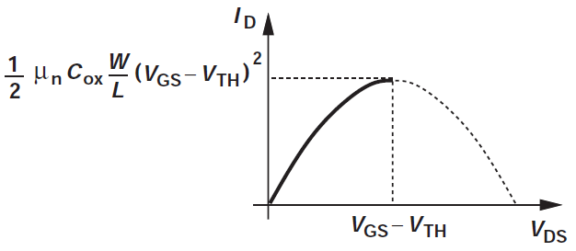
Derivation of I/V Characteristics(6)
Second, for a constant V_{GS}, I_{D} varies parabolically with V_{DS}, reaching a maximum of
at V_{DS} = V_{GS} − V_{TH}.
The nonlinear relationship between I_{D} and V_{DS} reveals that the transistor cannot generally be modeled as a simple linear resistor. However, if V_{DS} « 2(V_{GS} − V_{TH}), Eq. (v) reduces to:
3

Slide 8
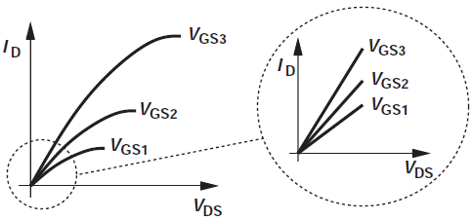
Derivation of I/V Characteristics(7)
exhibiting a linear I_{D}-V_{DS} behavior for a given V_{GS}. In fact, the equivalent
on-resistance is given by V_{DS}/I_{D}:
From another perspective, at small V_{DS} (near the origin), the parabolas in Fig. can be approximated by straight lines having different slopes.
Eq. (vi) suggests that the on-resistance can be controlled by the gate-source voltage. In particular, for V_{GS} = V_{TH}, R_{on} = ∞, i.e., the device can operate as an electronic switch.
3

